Slide 1
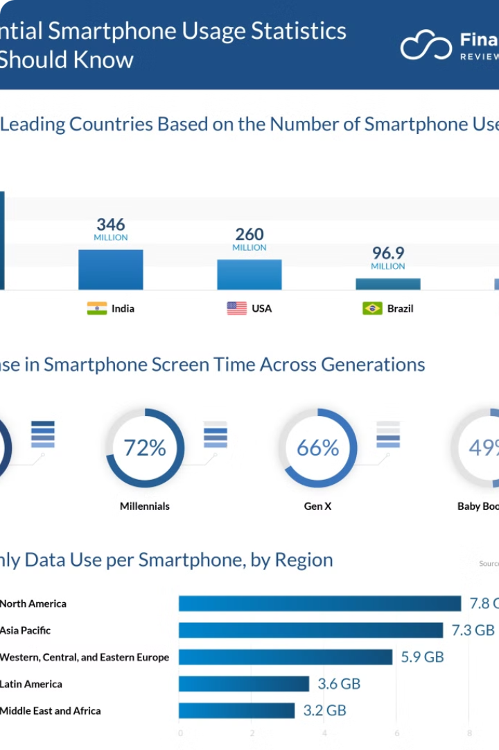

Telecom Customer Analysis
This presentation explores customer behavior and satisfaction in the telecom industry. We'll delve into data analysis techniques to gain valuable insights and drive data-driven decision-making.
by vicky saini

Slide 2

Why Customer Analysis Matters
1
Tailored Solutions
2
Customer Satisfaction
Gain deep insights to provide tailored solutions that meet individual customer needs.
Identify areas for improvement and enhance customer satisfaction through data-driven insights.
3
Business Outcomes
Drive data-driven decision-making for better business outcomes and increased profitability.

Slide 3
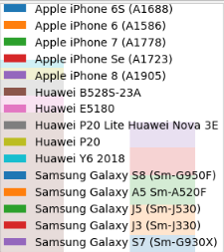
Exploratory Data Analysis (EDA)
1
Data Understanding
2
Data Cleaning
Get to know the data and its structure, identifying key variables and relationships.
Detect and handle missing values and outliers to ensure data quality and accuracy.
3
Data Storytelling
Uncover the story behind the data, revealing patterns and trends that drive insights.

Slide 4
User Overview Analysis
Top 10 Handsets
Top 3 Manufacturers
Top 5 Handsets per Manufacturer
Identify popular devices
Understand market trends
Target specific device models

Slide 5
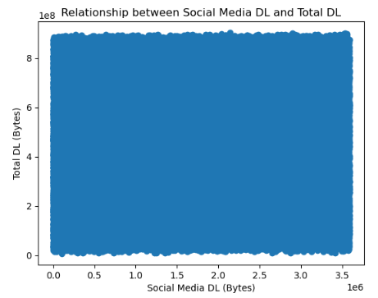
User Behaviour Analysis
Session Data
Application Usage
1
2
Aggregate user data, including number of sessions, duration, and data usage.
Analyze total data volume per application, identifying popular apps and user preferences.

Slide 6
Exploratory Data Analysis
1
Variable Description
Describe relevant variables and their data types, ensuring data understanding.
2
Basic Metrics
Analyze basic metrics like mean, median, and standard deviation to understand data distribution.
3
Univariate & Bivariate Analysis
Conduct univariate and bivariate analyses to explore relationships between variables.
4
Dimensionality Reduction
Perform PCA for dimensionality reduction, simplifying data analysis and visualization.

Slide 7
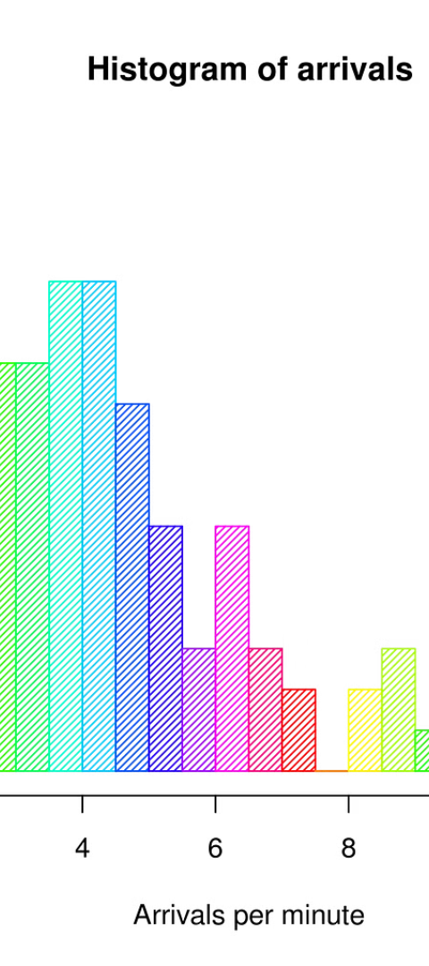
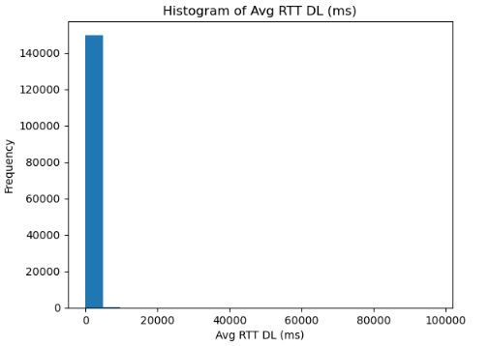
Univariate Analysis
1
Dispersion Parameters
Compute and interpret dispersion parameters for quantitative variables, such as variance and standard deviation.

Slide 8
Bivariate Analysis
1
Application & Data Usage
2
Insightful Interpretations
Explore relationships between applications and total download and upload data, revealing usage patterns.
Provide insightful interpretations of the relationships observed, highlighting key findings and implications.

Slide 9
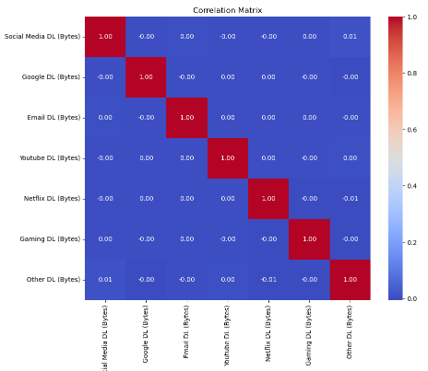
Correlation Analysis
1
Correlation Matrix
2
Correlation Findings
Compute a correlation matrix for social media, Google, email, YouTube, Netflix, gaming, and other data.
Interpret the correlation findings, identifying strong and weak relationships between variables.

Slide 10
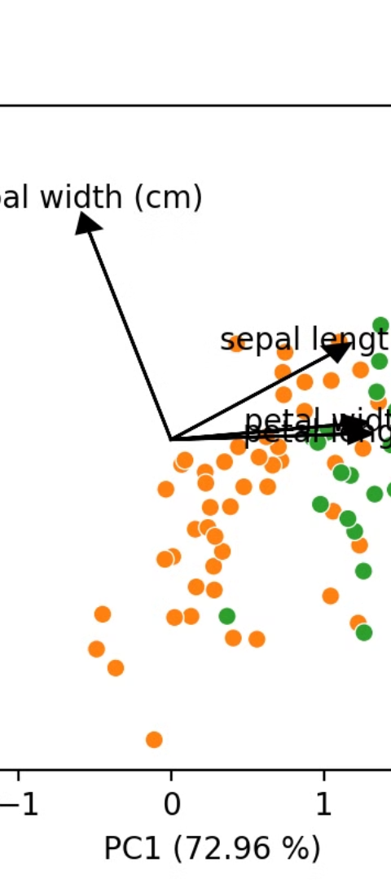
Dimensionality Reduction
1
PCA Implementation
2
PCA Interpretation
Perform PCA to reduce data dimensions, simplifying analysis and visualization.
Provide meaningful interpretation of PCA results, explaining the reduced dimensions and their significance.

Slide 11

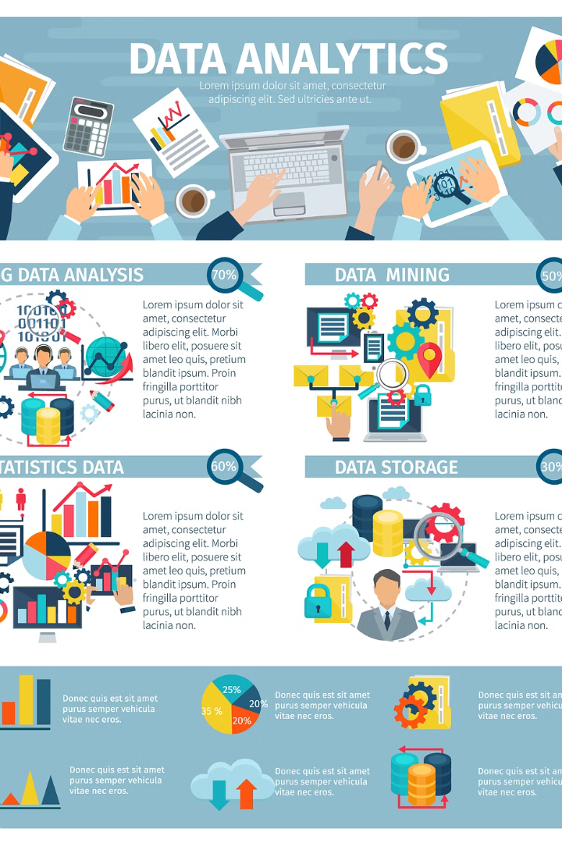
User Engagement Analysis
This presentation explores user engagement and experience analytics. We will analyze user activities, engagement metrics, and network performance to understand user behavior and satisfaction.

Slide 12
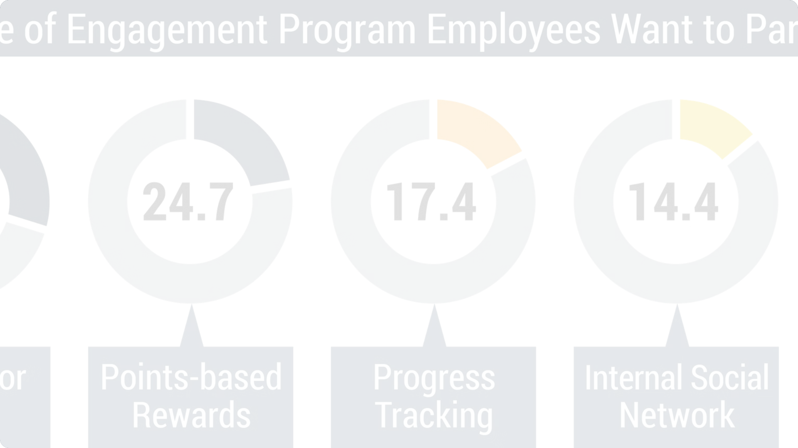
User Engagement Analysis
1
Track User Activities
2
Compute Engagement Metrics
Track user activities on database sessions.
Compute engagement metrics such as session frequency, duration, and total traffic.

Slide 13
Engagement Metrics
Aggregate Metrics
Report Top Customers
Aggregate metrics per customer ID (MSISDN).
Report top 10 customers per engagement metric.

Slide 14
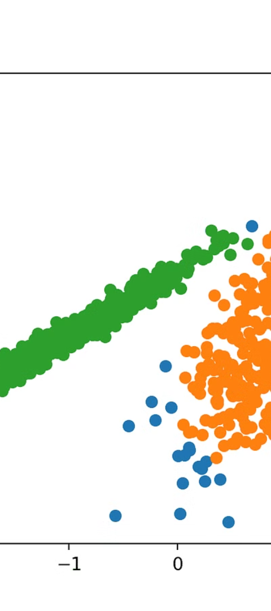
K-Means Clustering
1
Normalize Metrics
2
Compute Cluster Metrics
Normalize engagement metrics and run k-means clustering with k=3.
Compute metrics for each cluster and interpret results visually.

Slide 15
Top Engaged Users
Application
Top 10 Users

Slide 16
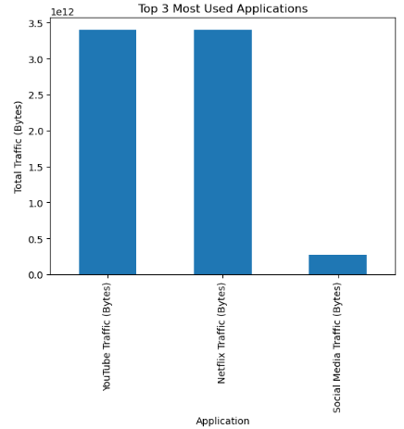
Top Applications
Application Usage
Plot the top 3 most used applications.

Slide 17

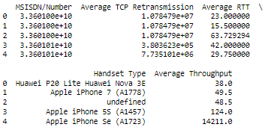
Experience Analytics
1
Network Parameters
2
Analyze Network Performance
Focus on network parameters and device characteristics.
Analyze average TCP retransmission, RTT, handset type, and throughput.

Slide 18
Experience Metrics
Throughput Distribution
TCP Retransmission
Report distribution of average throughput per handset type.
View average TCP retransmission per handset type.

Slide 19
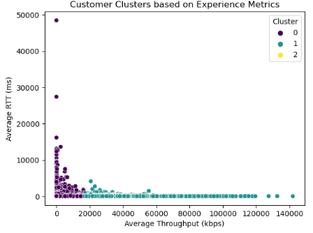
K-Means Clustering
1
Segment Users
Segment users into experience groups using k-means clustering with k=3.
Describe Clusters
2
Describe each cluster briefly.

Slide 20
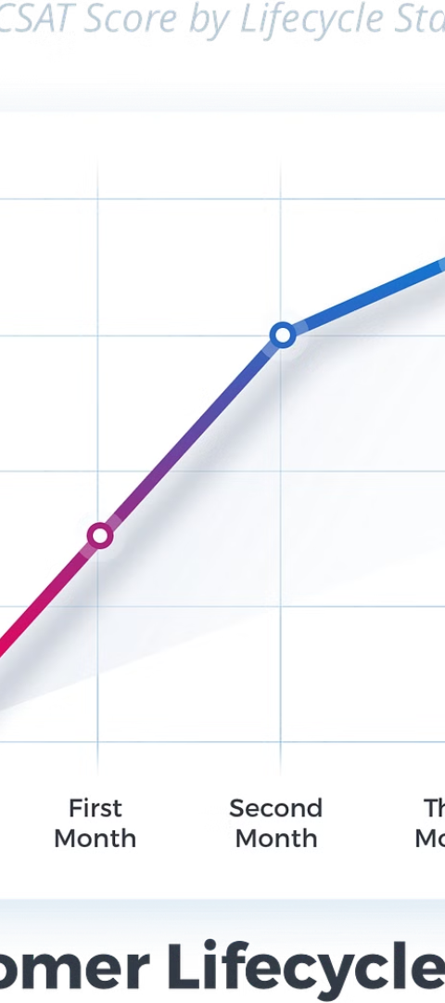
Satisfaction Analysis
1
Analyze Satisfaction
2
Assign Scores
Analyze customer satisfaction in depth.
Assign engagement and experience scores to each user.
3
Report Top Customers
Compute overall satisfaction score and report top 10 satisfied customers.

Slide 21
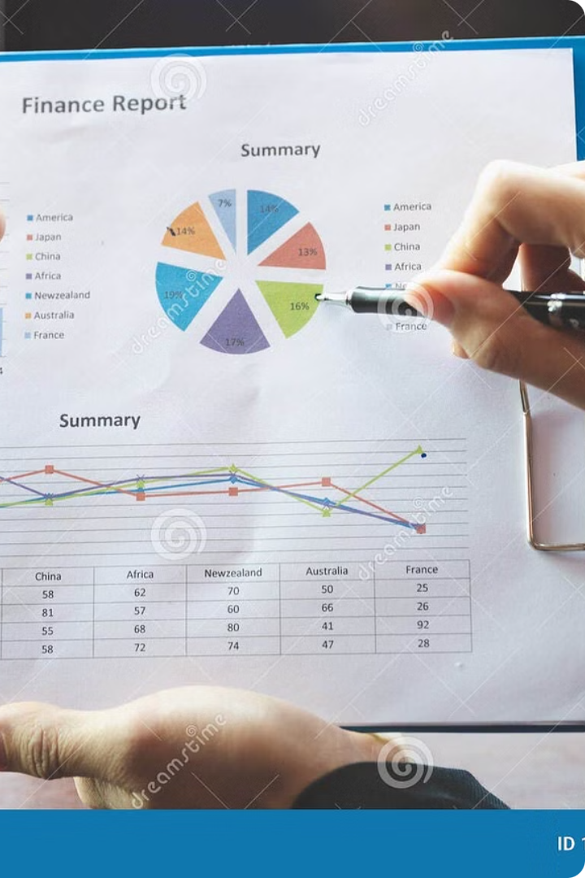
Customer Insights: A Data-Driven Approach
This presentation outlines key findings from our customer data analysis.

Slide 22
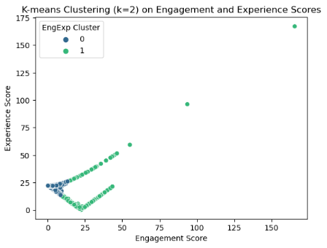
Satisfaction Scores
Regression Model
1
Predict satisfaction scores.
2
K-Means Clustering
Cluster engagement and experience scores.

Slide 23
Satisfaction Scores (cont.)
Cluster
Average Satisfaction
Average Experience
Cluster 1
4.2
4.5
Cluster 2
3.8
3.2

Slide 24
Key Findings
Demographics
Engagement Trends
User Experience
Majority of customers are aged 25-40.
Session duration increased by 15%.
Improved average RTT.

Slide 25




Growth Potential
Increased Engagement
Session duration increased.
Improved Experience
Enhanced service speed.
Strong Growth
Positive growth potential.

Slide 26


Customer Satisfaction
Stable Satisfaction
Support Concerns
Positive service feedback.
Concerns about support.

Slide 27
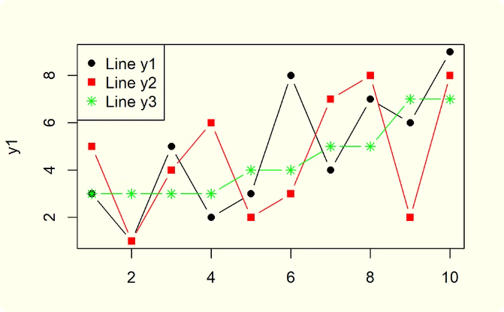
Data Summary
Engagement Trends
Customer Demographics
Session duration over time.
Age distribution of customers.

Slide 28
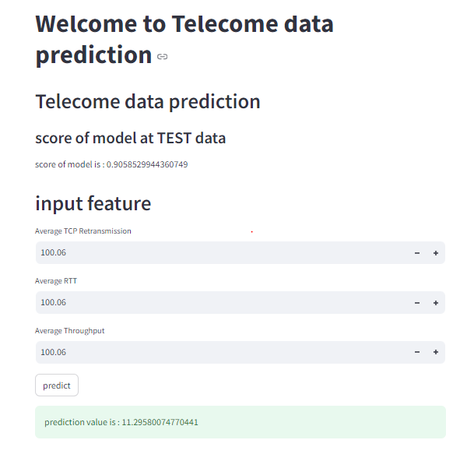
Deployment of Important Features and Results
Screenshot of the deployment interface
.

